Slide 1
Week 3
Inference: Confidence intervals

Slide 2
Session overview
Topics
Examples
Inferential statistics
Confidence intervals
Trends over time
Titanic
US Dept. of Health covid-19

Slide 3
Purpose of statistics
Description of the population or sample.
Inferences from the sample to the population.
Values that refer to the sample are called statistics.
Values that refer to the population are called parameters.

Slide 4
Different reasons for making inferences
Reasons
Examples
Generalize my sample results to the bigger population.
Check to see if 2 groups have significantly different rates.
Assess if a trend meets or exceeds a target.
Test a hypothesis.
Calculate the average LOS of patients in my hospital to estimate it for the entire multi-center system.
Compare if LA and NY differ significantly in covid death rates.
My medical center’s readmission rate in the last 3 months is better than the region’s target level.
The intervention program reduced CHF deaths 20%. Is it significant?

Slide 5
Comparison of analysis statements
Descriptive
Inferential
The average age of the 30 heart clinic patients I treat is 65 years.
The standard deviation (SD) of the age of the heart clinic patients I treat is 15 years. Therefore, about 95% of my sample (2 SDs) is aged 30 to 90.
The average age of California heart clinic patients is estimated to be 65 years.
We are 95% confident the average age of CA clinic patients is between 59 and 71. If we sample 100 groups of patients, we expect to see average ages of 59 - 71 in about 95 of the 100 groups.

Slide 6
Glossary
*Sampling distribution: A distribution of statistics from the sample. For example, a sampling distribution may have the means from many samples on patient age, difference in group means, correlation coefficients, etc. The sampling distribution is a fundamental part of most statistical tests.
Sampling error: The dispersion (spread) of the sampling distribution.
Standard error of the mean: The standard deviation of the sampling error. A small standard error tells us that the sample statistic is a reliable estimate of the corresponding population mean because the parameter is always close to the sample statistics by default.
Confidence interval: A range of the sampling distribution that a population parameter falls within, given a specified confidence level (e.g., 95%) .

Slide 7
Inferences
We estimate population parameters from our sample statistics.
Estimating the parameter is complex because it is rarely known so we measures it with a level of confidence (e.g., 95%).
These values are commonly referred to as point estimate (mean or average) and confidence intervals (e.g., 95% confidence interval).
We use 95% because the tails can go to infinity. Intervals of 100 to 200 vs. 0 to 10,000. Intervals need to be helpful, 100% CIs are not.
The inverse of a confidence intervals is the p-value. For example, if we know the 95% confidence interval for LOS is 2 to 7 days but a competing medical system has a mean LOS of 12 days, we would know the difference between us and them is at least significant at p < 0.05 level. No math is needed when you know the 95% CI (or graph it).

Slide 8
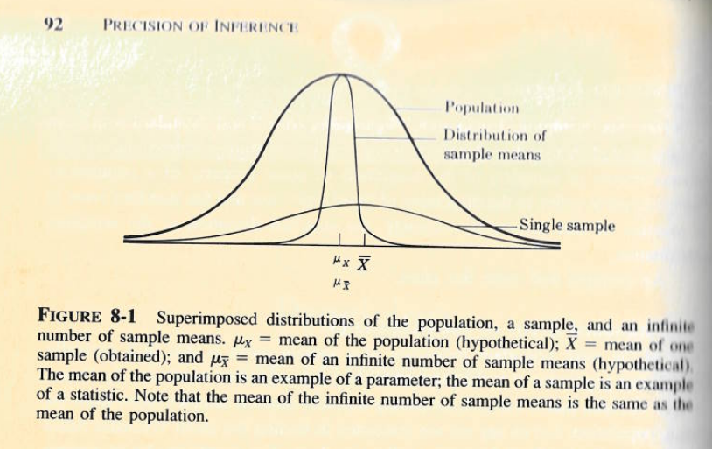
Different types of distributions
Though rarely known, we try to estimate the population distribution.
It is important to note that distributions of sample means represent many individuals (e.g., a value of 50 might represent the mean age of 100 patients).
We use formulas to calculate the distribution of sample means (i.e., we generally don’t use multiple samples).

Slide 9
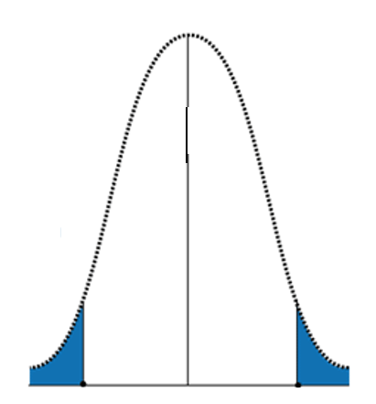
More on sampling distributions
Red circles represent the mean values from infinite samples. This forms the sampling distribution.
Red circles within the white area are in the normal range, this is 95% of the area. We have a 95% level of confidence that if we get another 100 samples, 95 would have a mean within that range
Remember the 68-95-99.7 rule when thinking of standard errors. The rule also applies to 1-2-3 standard errors. SEs are the SDs of sampling distributions.
95% is a common confidence interval but other routine values are 90% and 99%.
Although rare, some values fall into the “rejection region” of the null hypothesis. When that happens, we say it is “significant”.
We can have 95% CIs on any estimated value: means, differences, correlation coefficients, etc.
e.g., clinic mean= 65, SE=5.

Slide 10
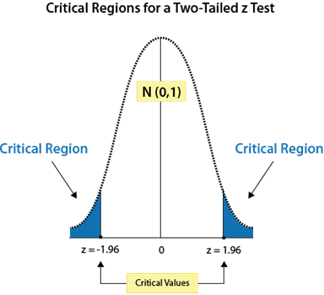
Confidence intervals and significance tests
The blue shaded region sums up to 5% of the graph area. This is the “p < 0.05” in statistical tests.
The white region between the blue is 95% of the graph area. This is the 95% Confidence interval.
For example, if our study’s rare group difference falls into the blue region, that indicates there is at most a 5% chance of being wrong when we say there is a significant difference. What determines “rare” is how far it is from 2 SEs around the mean.
A significance test and 95% confidence intervals are reciprocals of each other. Once you know one value, you know the other. 95% CIs have other qualities that make them useful.

Slide 11
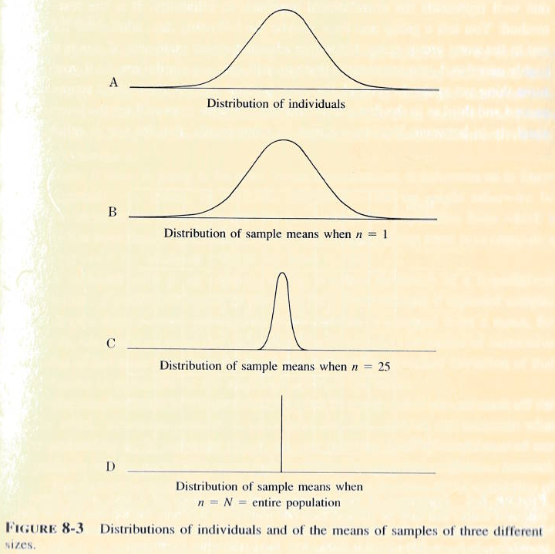
Sampling distributions get smaller when sample sizes get bigger
It’s important to note that as the number of sample means gets bigger, the distribution get narrower.
Big data can make minor things look significant because sample size is part of the formula. Be careful in interpreting results.

Slide 12
Examples
95% Confidence intervals of Titanic survival, inpatient bed utilization, and Tableau

Slide 13
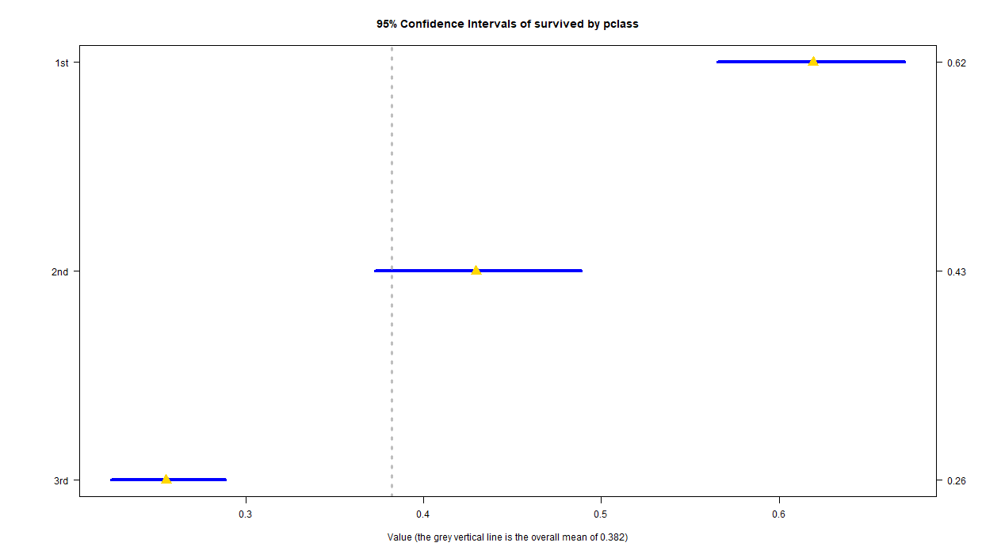
Titanic survival by passenger class
To interpret the results, any gold triangles (means) that do not fall within the blue bar (95% CIs) of a different passenger class are significantly different.
For example, 1st and 2nd classes are different because the gold triangle of 2nd class doesn’t lie within the blue bar of first class. And vice-versa.
The overall average (vertical gray line) falls within the 95% CI of 2nd class. We can say their survival rate is “average” because the overall average falls within the normal range of 2nd class.
The CI is the mean +/- the “margin of error”

Slide 14
Consistently higher inpatient bed use over time in the US.
5 of the 6 regions have rates over the 70% threshold by September, 2021.

Slide 15
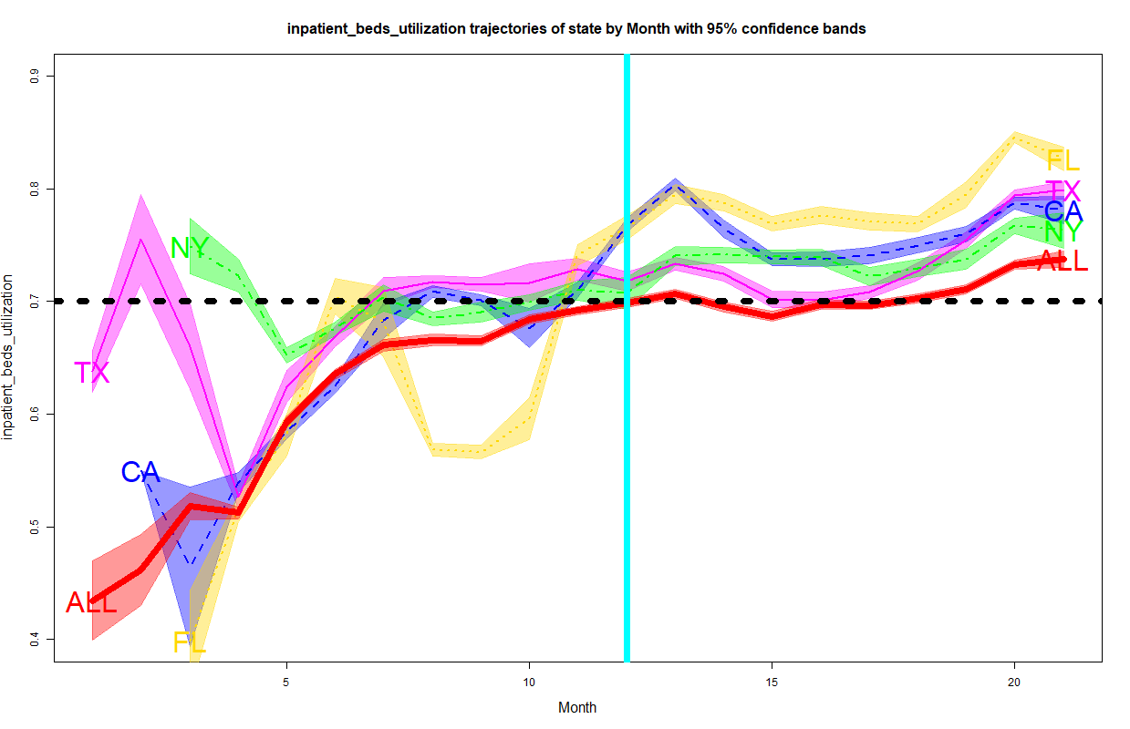
Florida is significantly higher than the other high covid case states for the last 6 months.
The bands are 95% confidence intervals. The lines in the middle are point estimates.
The red band represents the national average. Values above and below the national 95% CIs are significantly different than the national average.
January, 2021

Slide 16
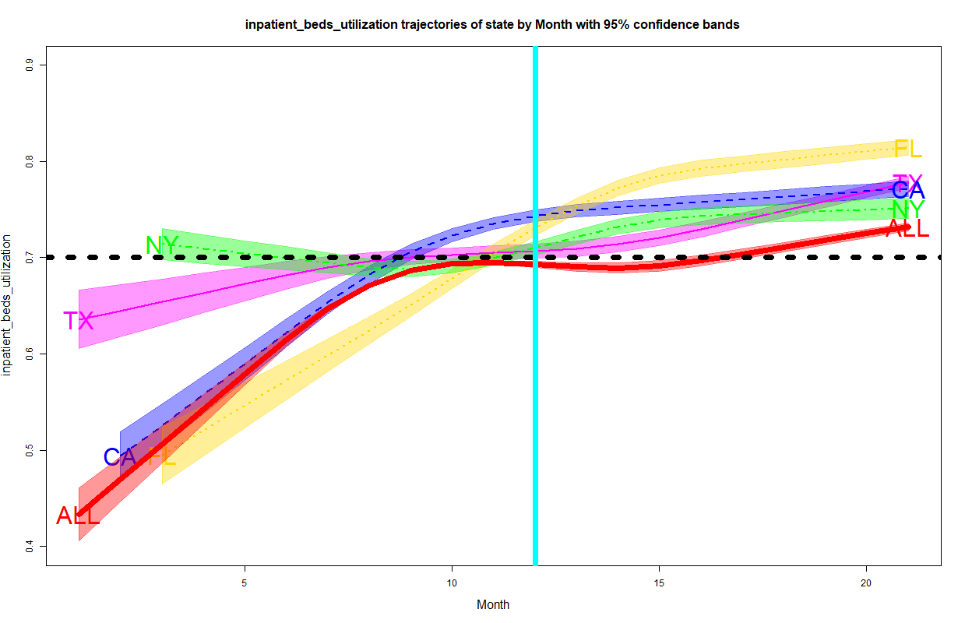
It is easy to see that Florida’s trend is significantly higher in the last 6 months.
Consider using curved lines (splines) to make it easier to see trends.
Like rolling 12 month averages or quarterly values, curved lines make it easier to view results.
Unlike rolling averages, we can see actual month results and variation over time.

Slide 17
Tableau example: Wilson 95% confidence interval formulas
Rate = SUM([Compliant])/COUNT([Compliant])
a = [Rate] + SQUARE(1.96)/(2*COUNT([Compliant]))
b = 1.96 * sqrt( ([Rate]* (1-[Rate]) + (SQUARE(1.96)/(4*COUNT([Compliant])))) /COUNT([Compliant]))
c = 1+ (SQUARE(1.96)/ COUNT([Compliant]))
Lower = ([a]-[b])/[c]
Upper = ([a]+[b])/[c]

